Slide 1

TWITTER DATA ANALYSIS(EPL): HADOOP2 MAP REDUCE FRAMEWORK
Guide-
Mr. D.K. Chitre
Nadeem Yoosuf
Shyam Nair
Umair Akhtar

Slide 2
INTRODUCTION
Consider a day in your life. You have to make many choices like: What should I eat for breakfast? Which route should I take to go to college/work? How can I do my work better? How can I optimize my day? What have others done in similar situations?
Your choices define your day. Hence you need to make the correct choice. Analysis of the data at hand will help you make the best decision
Analysis of data uncovers individual characteristics of the subject and these trends and characteristics can be used in all fields of Science
Similarly, in football, we can find out which is the most popular team, most popular player, etc.

Slide 3
PROBLEM DEFINITION
PROBLEM
In order to analyse data, we need to choose the site from where we collect data.
Social media sites contain a lot of data in the form of tweets and hashtags. Another added advantage of social media sites is that they encompass the people’s sentiment and their thoughts
SOLUTION
So our project, Twitter Data Analysis (EPL) will statistically represent, in the form of graphs, the most popular teams, the trending topics and the recent tweets by most popular users.
Representing data in the correct form is of utmost importance as we want even the common layman to understand.

Slide 4

Objective and Scope
The Project aims to analyze data about the English Premier League (Football) which is obtained from Twitter. Tweets and most popular hashtags are recorded, which would give information such as: Most active users, most popular team, the popularity of those teams in different parts of the world, etc.
The main sections of this project would be:
Content Retrieval: The large amount of data is collected using java Twitter streaming API.
Data Processing: Data collected over a period of time is processed by using parallel and distributed processing software framework developed by Apache Hadoop and using map reduce programming model.

Slide 5
3. Storage: This data is stored in a certain format so as to form key value pair which is needed to feed to mapper in map-reduce programming approach. The data is stored in Hadoop2 Distributed File System.
4. Data Analysis: The output obtained from reducer phase is analysed using a data analysis tool like RStudio in language R.
5. Visualization: Various ongoing trends on social networking sites are aesthetically represented using plotting libraries in R.

Slide 6

MOTIVATION
The motivation for doing this project was mainly an interest in undertaking a challenging project in an interesting area of big data analysis. The opportunity to learn about a new area of computing not covered in lectures was appealing to us.
It would be very interesting to gather and then aggregate the social networking data so as to extract interesting patterns and recent trends from it.
Since Hadoop is a very popular and relatively easy language which is used for processing data, we were excited to work with Hadoop
We will also be introduced to a statistical programming language for the first time: R language

Slide 7
MOTIVATION (cont.)
We also hope that our findings, our research and our product can at least slightly contribute to mankind.
If the main objective of this project is fulfilled, then it would be beneficial to many football fans and other organizations like “OptaStats” who use this information and provide it to football clubs who want better results.
This project can make football more interesting and more appealing for fans to watch

Slide 8
LITERATURE SURVEY
We need knowledge of Hadoop, R and Twitter API to construct our project
Twitter API extracts the tweets, which is the data we will use.
Hadoop will be mainly used to store and organize the data
We can install Hadoop and its virtual machine from this website: https://ccp.cloudera.com/display/SUPPORT/Demo+VMs
R will be used to aggregate and display the data in an attractive way with all the necessary statistical information
We can install R from:
A paper from IJRDET tells us that the total market worth of Big Data is around US $ 100 Billion. Hadoop is the leading software used for Big Data Analysis

Slide 9

Hadoop
Apache Hadoop is a source software written in Java for distributed & distributed processing of very large data sets on computer built from commodity hardware
Cheaper
Scales to Petabytes or more
Faster
Parallel data processing
Better
Suited for particular types of BigData problems
Hadoop has 3 core parts: The HDFS, MapReduce API and other libraries

Slide 10
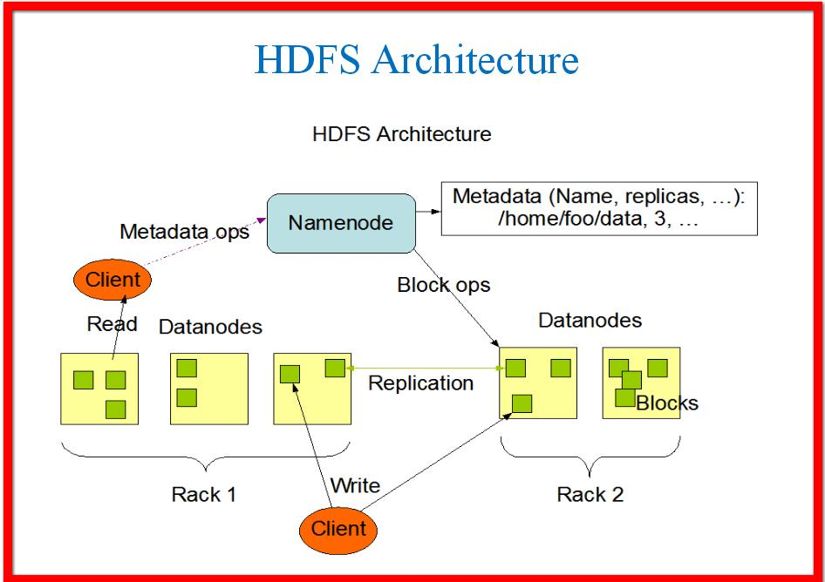
HDFS ARCHITECTURE
The Hadoop distributed file system (HDFS) is a distributed, scalable, and portable file-system written in Java for the Hadoop framework.
It has many similarities with existing distributed file systems.
Highly supports communication of data. All HDFS communication protocols are layered on top of the TCP/IP protocol.
It stores each file as a sequence of blocks. The blocks of a file are replicated for fault tolerance.
Everything about HDFS here! https://hadoop.apache.org/docs/r1.2.1/hdfs_design.html

Slide 11
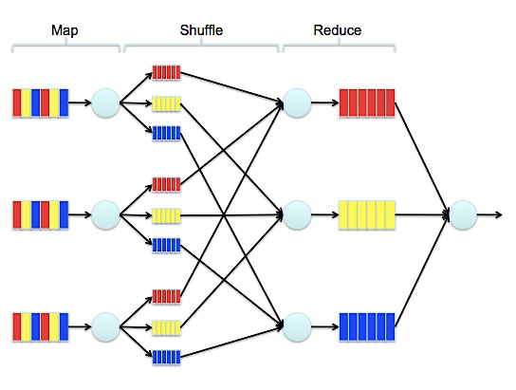
MAPREDUCE FRAMEWORK
The volume of data with the speed it is generated makes it difficult for the current computing infrastructure to handle big data. To overcome this drawback, big data processing can be performed through a programming paradigm known as MapReduce.
MapReduce is a programming model and an associated implementation for processing and generating large data sets with a parallel, distributed algorithm on a cluster.

Slide 12
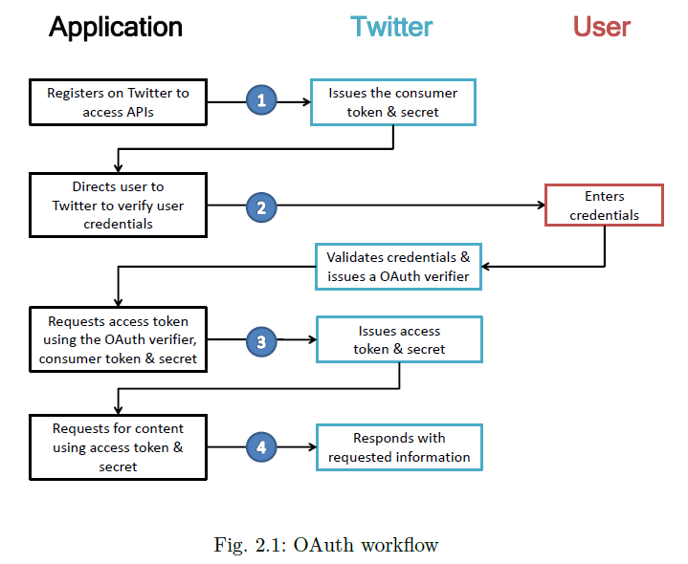
TWITTER API
An Application programming interface (API) is a set of routines, protocols, and tools for building software applications.
A good API makes it easier to develop a program by providing all the building blocks. A programmer then puts the blocks together.
How to extract data from Twitter API here:

Slide 13
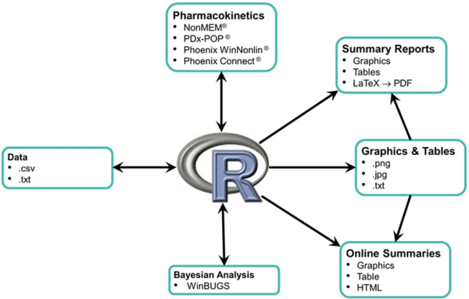
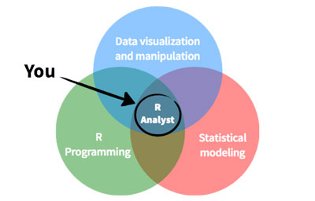
R Language
R is a programming language and software environment for statistical computing and graphics.
R's popularity has increased substantially in recent years.
Verified course to learn R Programming: https://courses.edx.org/courses/course-v1:Microsoft+DAT204x+3T2015/info

Slide 14
Implementation
PREREQUISITES:
Rstudio version – installed in computer.
In order to extract tweets, we will need a Twitter application and hence a Twitter account.
Using the Twitter login ID and password, sign in at Twitter Developers.

Slide 15
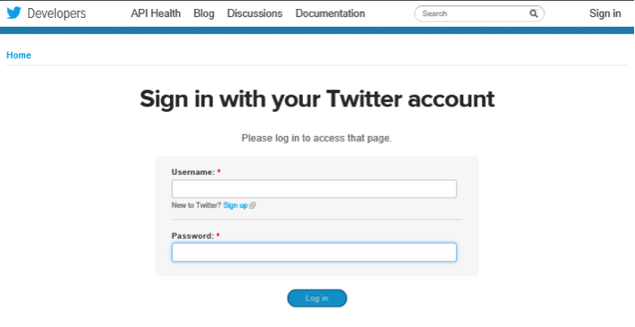
1. To Create Twitter Application
a.

Slide 16
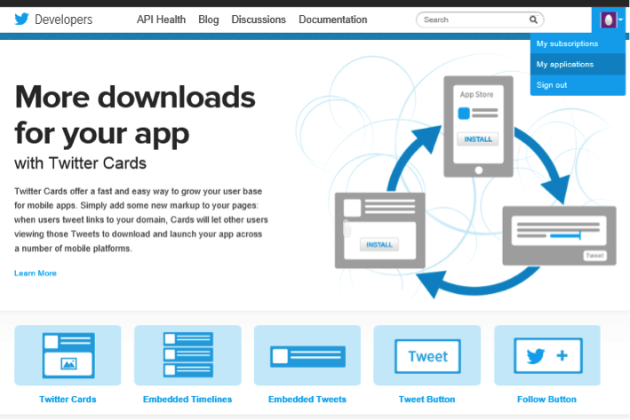
b. Navigate to My Applications in the upper right hand corner.

Slide 17
c. Create a new application.
d. Fill out the new app form. Names should be unique, i.e., no one else should have used this name for their Twitter app.
- Give a brief description of the app.
- You can change this later on if needed. Enter your website or blog address.

Slide 18
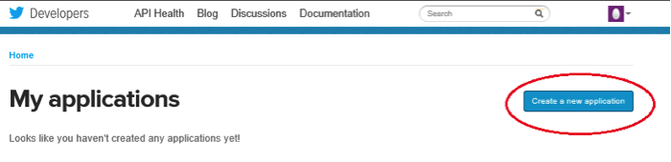
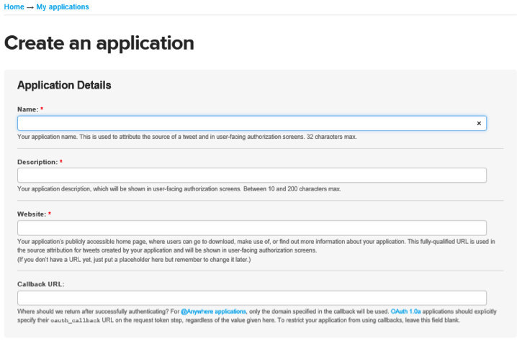

Slide 19
e. Scroll down and click on “Create my access token” button.
f. Note the values of consumer key and consumer secret and keep them handy for future use.

Slide 20
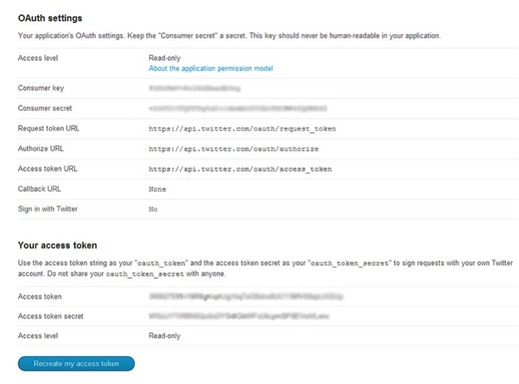

Slide 21
2. INSTALL AND LOAD R PACKAGES
install.packages("twitteR")
install.packages("ROAuth")
library("twitteR")
library("ROAuth")

Slide 22
3. EXTRACT TWEETS
Load “twitter authentication.Rdata” file in your session and run registerTwitterOAuth.
This should return “TRUE” indicating that all is good and we can proceed.
Then we set two variables, one for the search string, which could be a hashtag or user mention, and the second variable is the number of tweets we want to extract for analysis.
load("twitter authentication.Rdata")
registerTwitterOAuth(cred)
search.string <- "#nba"
no.of.tweets <- 100
tweets <- searchTwitter(search.string, n=no.of.tweets, cainfo="cacert.pem", lang="en")
tweets

Slide 23
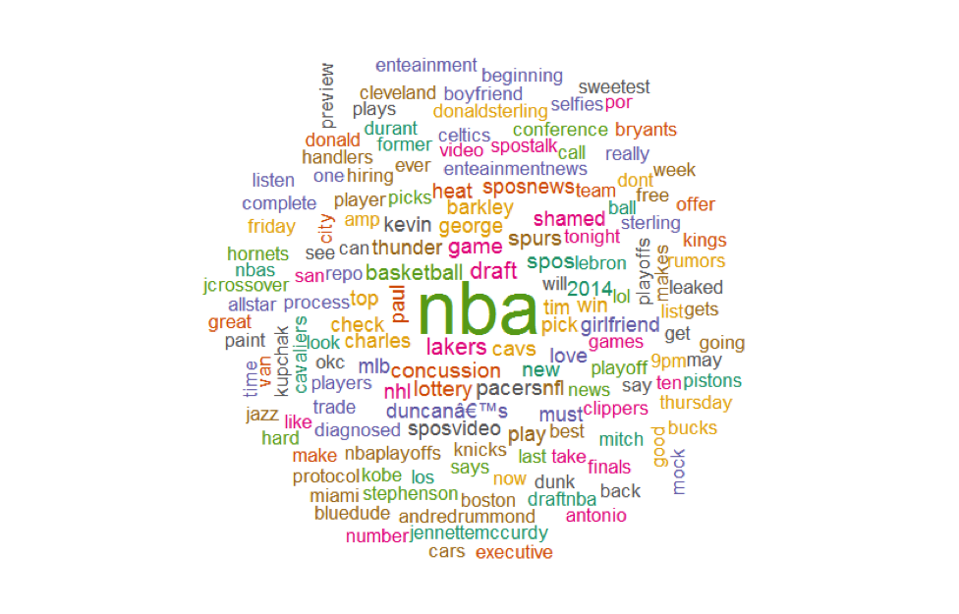
For Example NBA(National Basketball Association)
The tags which we might look out for
The Word cloud of NBA:

Slide 24
4. CLEAN UP TEXT
We have already been authenticated and successfully retrieved the text from the tweets using #nba.
The first step in creating a word cloud is to clean up the text by using lowercase and removing punctuation, usernames, links, etc.
We are using the function gsub to replace unwanted text.
#convert all text to lower case
tweets.text <- tolower(tweets.text)
# Replace blank space (“rt”)
tweets.text <- gsub("rt", "", tweets.text)
# Replace @UserName
tweets.text <- gsub("@\\w+", "", tweets.text)
# Remove punctuation
tweets.text <- gsub("[[:punct:]]", "", tweets.text)
.
.

Slide 25
5. CREATE THE GRID
Now that we have extracted and scored the tweets for each team, we want to graph the results. Here we will use a line graph to display the results.
The y-axis displays the average sentiment score of tweets. The x-axis shows the time the tweet was created.
The two plots are arranged on a grid using the gridExtra package. The legend on the side helps map time to game events

Slide 26
SPURS
OKC THUNDER
TIME | SCORE
20:00 | +0.25
20:10 | +0.26
20:20 | +1.3
20:30 | +0.8
20:40 | +0.1
20:50 | 0
21:00 | +0.1
21:10 | +0.85
21:20 | +0.3
21:30 | +0.25
21:30 | +1.1
21:50 | +0.75
22:00 | +0.8
22:10 | +0.85
22:20 | +0.45
22:30 | +1.5
TIME | SCORE
20:00 | +0.5
20:10 | +0.1
20:20 | +1.55
20:30 | +0.75
20:40 | +0.6
20:50 | +0.45
21:00 | +0.25
21:10 | -0.2
21:20 | -0.55
21:30 | 0
21:40 | 0.15
21:50 | -0.2
22:00 | 0
22:10 | -0.25
22:20 | -0.45
22:30 | +0.5

Slide 27
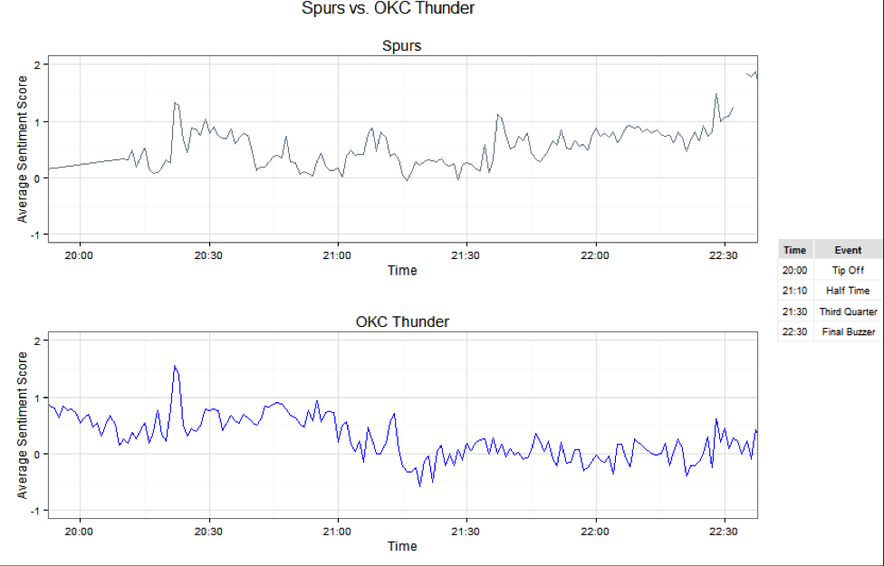

Slide 28
Code for Previous Graph Presentation
#plot by time and average score
plot.OKCThunder <- ggplot(OKCThunder.summary, aes(x=created, y=avg))+ geom_line(color='blue')+ scale_x_datetime(limits = c(as.POSIXct(strptime("2014-05-22 20:00", "%Y-%m-%d %H:%M")), as.POSIXct(strptime("2014-05-22 22:30", "%Y-%m-%d %H:%M")))) + labs(title = "OKC Thunder", x = "Time", y = "Average Sentiment Score") + ylim(-1, 2) +theme_bw()
plot.Spurs <- ggplot(Spurs.summary, aes(x=created, y=avg))+ geom_line(color='slategray')+ scale_x_datetime(limits = c(as.POSIXct(strptime("2014-05-22 20:00", "%Y-%m-%d %H:%M")), as.POSIXct(strptime("2014-05-22 22:30", "%Y-%m-%d %H:%M")))) + labs(title = "Spurs", x = "Time", y = "Average Sentiment Score") + ylim(-1, 2) + theme_bw()
#create legend for grid
legendtable <- data.frame(Time = c('20:00', '21:10', '21:30', '22:30'), Event = c("Tip Off","Half Time", "Third Quarter","Final Buzzer"))

Slide 29
The Dashboard
So, now comes the part of displaying the data. What all is included in our dashboard?
Top teams of English Premier League
Their popularity based on the social network hashtags
Stats of teams during a period
Stats of players during the same period
.
.
.

Slide 30
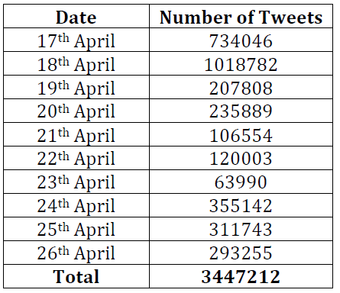
Amount of data collected and details
1. Data is collected for different ranges of dates (day-range , week-range)
2. Total of 300 MB data is collected over the period from 17th April to 26th April.

Slide 31
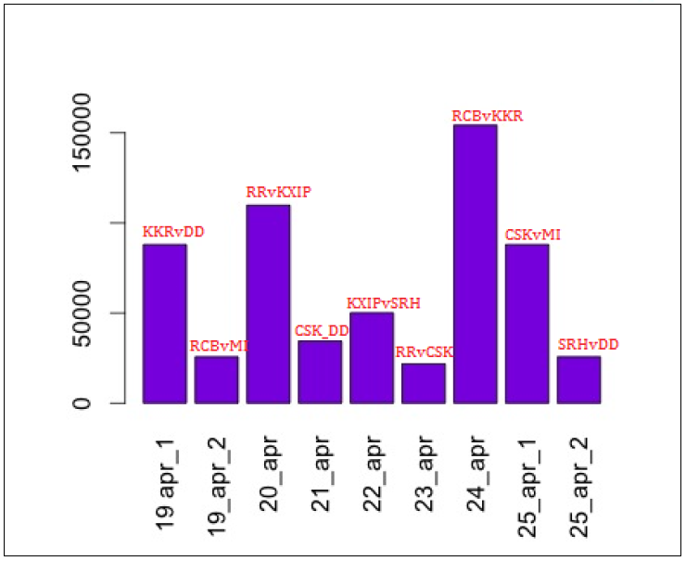
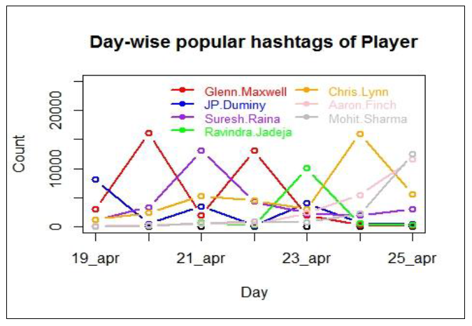
Stats of Teams during period 19Apr to 25 Apr
Players Stats for the same period

Slide 32
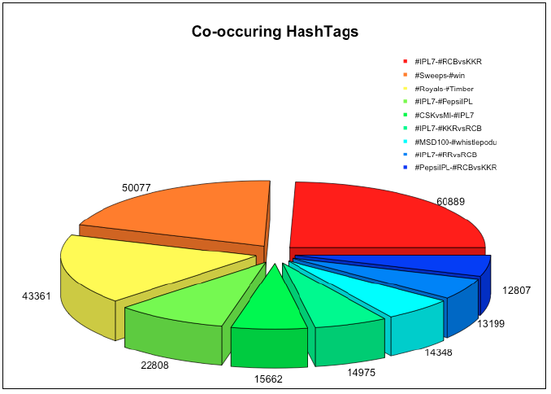
Pie chart displaying hash tags occureances
Hash tags Textplot by day

Slide 33
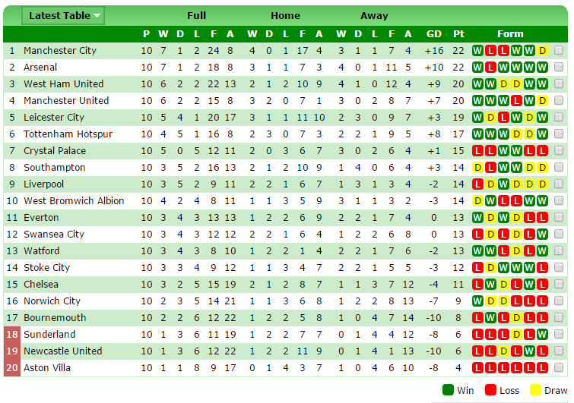

Slide 34
The teams of Barclays Premier League are listed with their present standings

Slide 35
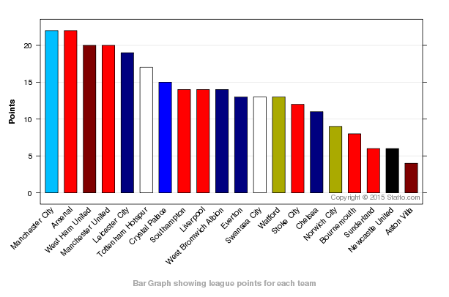

Slide 36
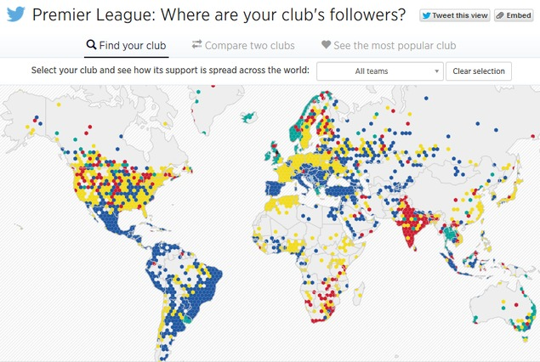
Who Should I follow?

Slide 37
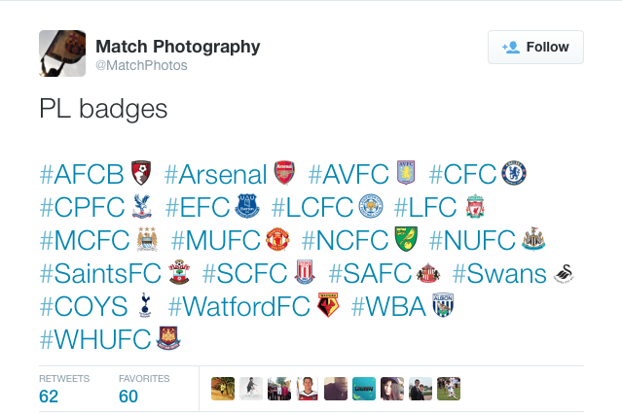
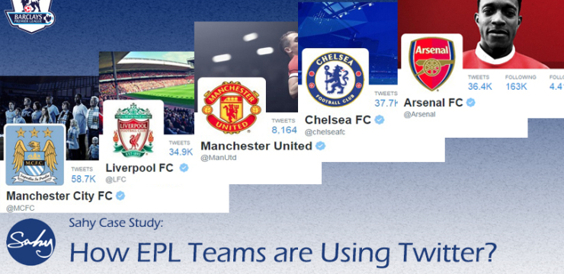

Slide 38
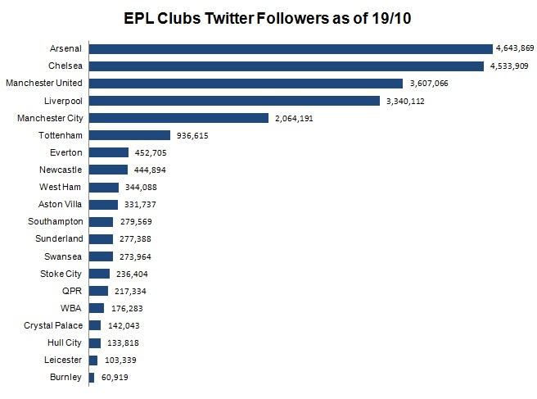
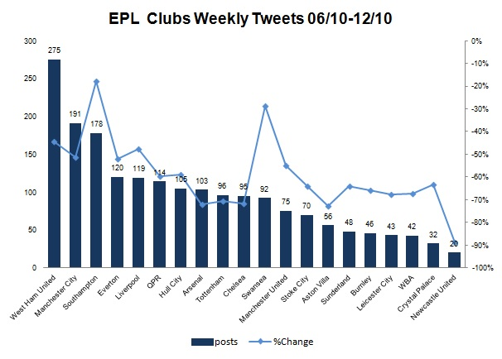

Slide 39
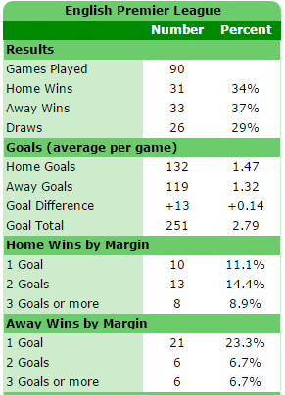
Stats necessary for our display in our dashboard

Slide 40
Feasibility and Analysis

Slide 41
Feasibility
Twitter API: The Streaming API is the real-time sample of the Twitter Firehose. This API is for those developers with data intensive needs. Streaming API allows for large quantities of keywords to be specified and tracked, retrieving geo-tagged tweets from a certain region, or have the public statuses of a user set returned. We used twitter API to get tweet text, date, username, follower count, retweet count. We also used filter query to collect topic specific tweet.
Data aggregator: we collect the data from twitter using Streaming API. Once the data is received, we clean the unwanted details from the tweets and save them in a set of regular files in a designated directory.
Data: Once the data collected we put this data into Hadoop’s /input directory so that map reduce program can read the data from this folder.

Slide 42
Data-Intensive Analysis (MR):
Setup Hadoop 2 for HDFS and Map Reduce infrastructure.
Designing and implementing the various MR workflows to extract various information from the data. (I) simple word count (ii) trends (iii) #tag counts (iv)@xyz counts etc.
Discovery: From the MR implementation we discover different knowledge about most trending words, hash tags, most co-occurring hash tags. The output files are converted into csv and visualization on this data is done in R.
Visualization: We analyse the discovered knowledge in R. We plot various graph to find the most trending words, hash tags. We analyse the data on daily/ weekly basis to find the current trend. Also uploads the result on website

Slide 43
Risk Analysis
Unreliable data
Fake data
Fake account
Hash tags misinterpreted

Slide 44
Analysis & Design

Slide 46
Data Analysis
Data is aggregated from Twitter using java Twitter Streaming API
Tweets for the current trending topic “Indian Premier League” are collected using filter query in Twitter API. Various hash tags for IPL are added as filter while collecting data.
Data is collected for different ranges of dates (day-range ,week-range)
Aggregated raw data is cleansed to some extend before analysing it using Map-Reduce methods.
• Removal of stop words
• Removal of hyperlinks
• Removal of punctuations

Slide 47
The format of collected tweets has following fields:
• Date
• User name
• Follower count of the user
• Tweet text
Each tweet is separated by new line and the above information is separated by a delimiter so that the processing in Map reduce is easy.

Slide 48
CONCLUSION
As we have entered an era of Big Data, processing large volumes of data has never been greater. In this Project we aim to serve a processed twitter tweet database to frontend third party visualization applications. Text analysis focused on processing the tweets to extract information from the raw data of tweet, which can benefit the frontend application in projecting more information to the user, in terms of usability and exploring text-engineered data.

Slide 49
REFERENCES
Big-data content retrieval, storage and analysis foundations of data-intensive computing Website: http://www.acsu.buffalo.edu/~mjalimin/
International Journal of Recent Development in Engineering and Technology Website: www.ijrdet.com (ISSN 2347-6435(Online) Volume 2, Issue 6, June 2014)
Big Data and the Future of Business http://www.technologyreview.com/view/538916/big-data-and-the-future-of-business/
https://www.credera.com/blog/business-intelligence/twitter-analytics-using-r-part
How-to: Analyze Twitter Data with Apache Hadoop http://blog.cloudera.com/blog/2012/09/analyzing-twitter-data-with-hadoop/

Slide 50
THANK YOU

